Slide 1
Modelling the mechanics of the plasma membrane and nuclear envelope: dynamics and disease
Advancement to PhD candidacy in Mathematical, computational and systems biology
Kathryn Manakova

Slide 3
Cell Surface Mechanochemistry and the Determinants of Bleb Formation, Healing and Travel Velocity.
Kathryn Manakova, Huaming Yan, John Lowengrub, Jun Allard

Slide 4
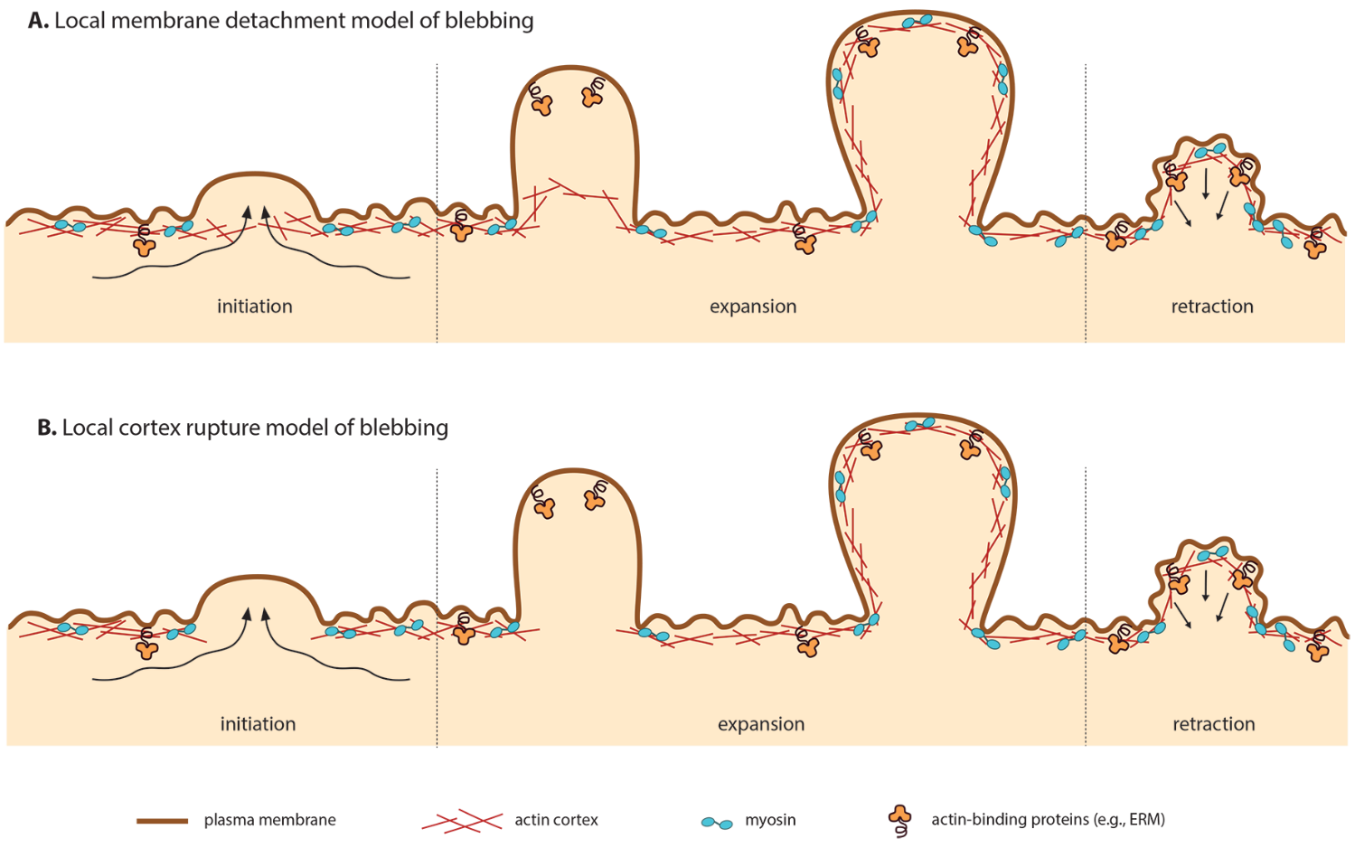
Cellular blebs are spherical pressure-drive cellular protrusions

Slide 5
Blebs are implicated in varius cell states/functions
Apoptosis/necrosis
Most commonly reported example of blebbing
Cytokinesis
Cell spreading
Virus infection
Cell migration
during development/tumour cells

Slide 6
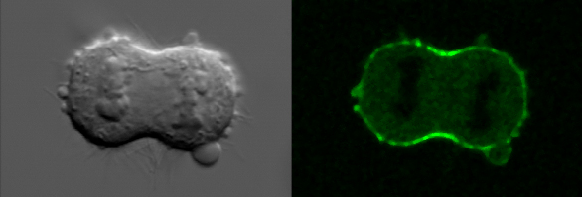
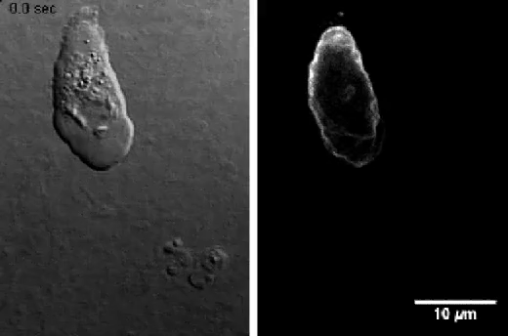
Blebs occur during cytokinesis and some cells use blebbing for cell migration
Blebbing during cytokinesis in a
mouse fibroblast (green: myosin-GFP).
http://www.mpi-cbg.de/research/research-groups/ewa-paluch.html
Bleb-driven chemotaxis of Dictyostelium cells
Kay et. al. JCB (2014)

Slide 7
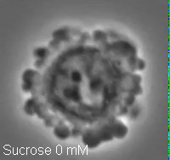
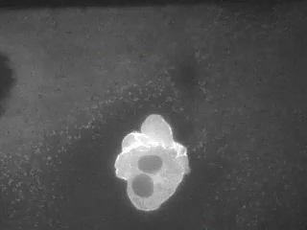
Stationary Bleb
Travelling Bleb
https://www.mtholyoke.edu/courses/rfink/Researchvideopages/rvideo3.htm

Slide 8
Stationary blebs are understood (theoretically and experimentally) while travelling blebs are not.
What determines whether a bleb will travel or remain stationary?
What determines travel velocity?
Strychalski et al 2012, 2014; Lim et al. 2012; Woolley et al 2016;
Charras et al., 2008; Paluch et al., 2014

Slide 9
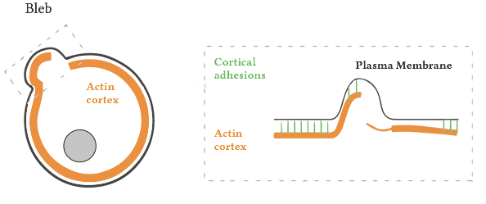
Mathematical model
Our simplified model consists of a single layer of actin cortex bound to the plasma membrane by adhesion molecules.

Slide 10
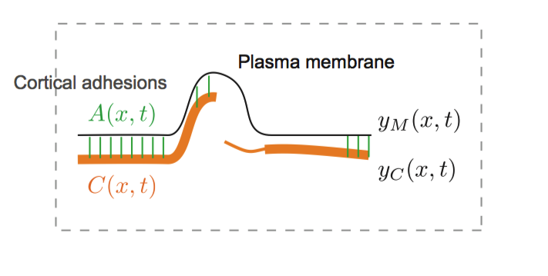
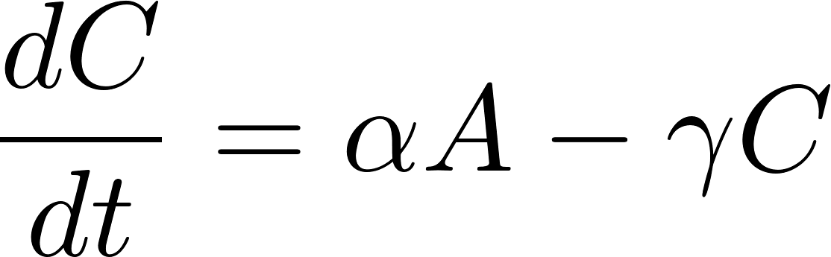
Mathematical model – chemical dynamics
Cortex thickness
Cortex assembly requires adhesion to membranes.
Adhesion density
Adhesion assembly requires cortex.
Adhesion assembly requires proximity to cortex.
Disassembly is force-sensitive.

Slide 11
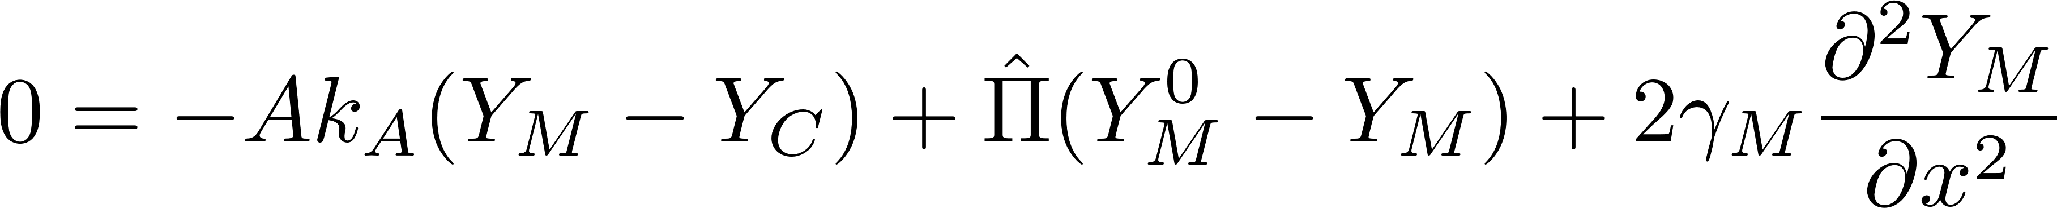
Mathematical model – Force balance equations
Force balance on the cortex
Adhesions (springs)
Myosin contractility
Force balance on the membrane
Adhesions (springs)
Pressure
Membrane deformation

Slide 12
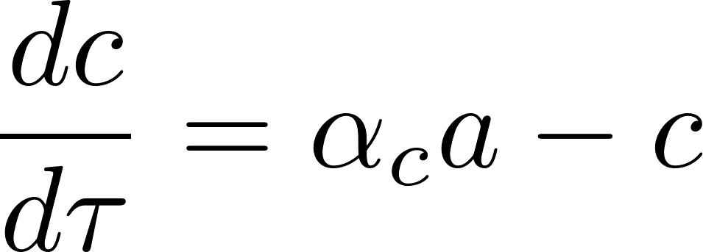
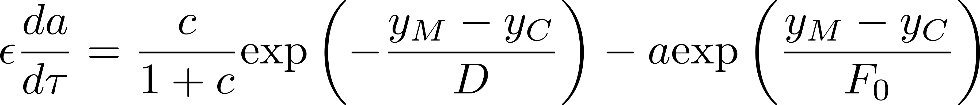
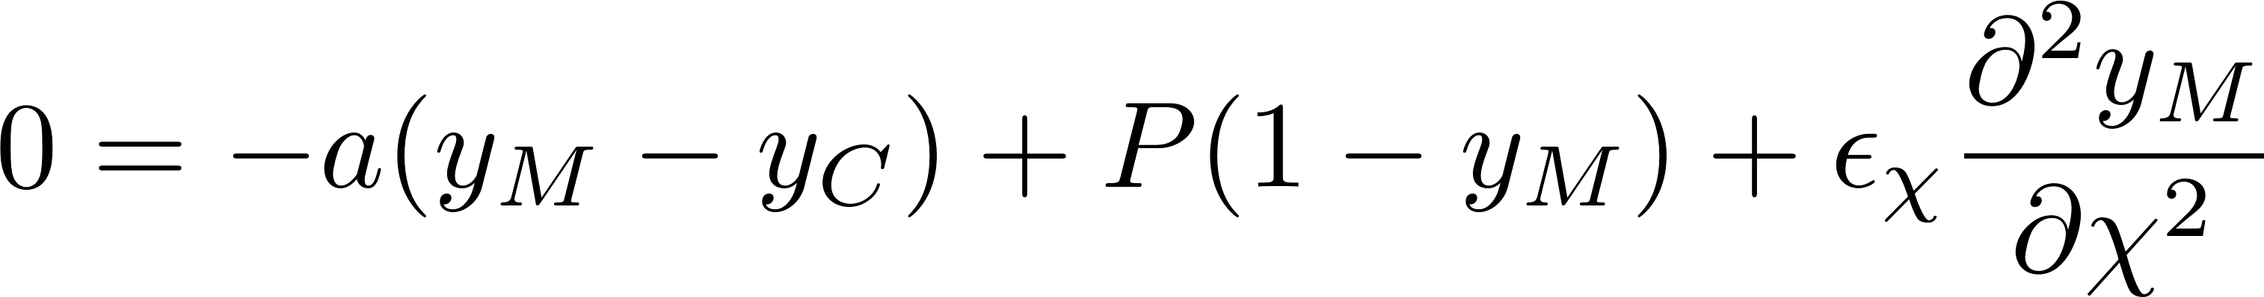
Mathematical model – full system of ND equations

Slide 13
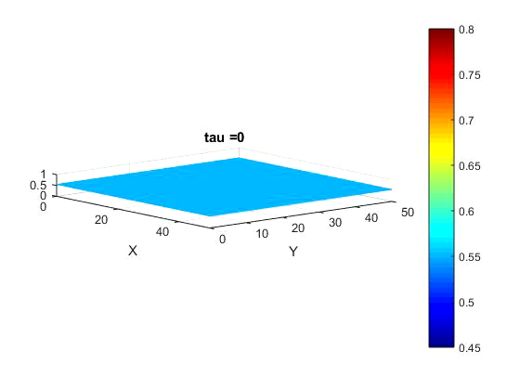
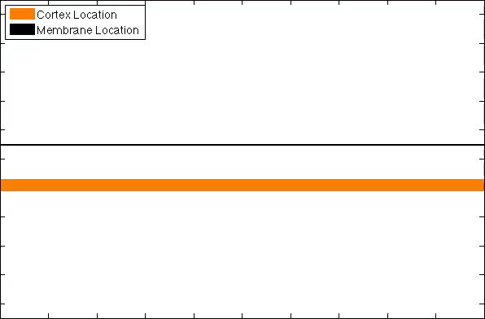
Results – Stationary blebs

Slide 14
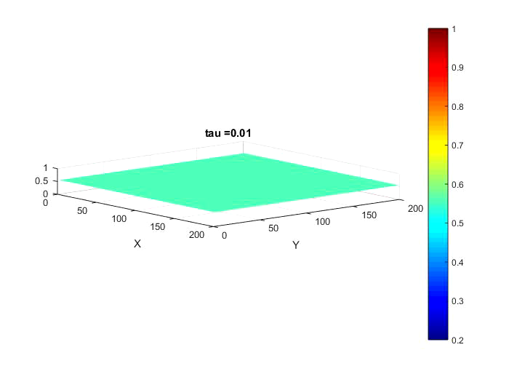
Results – Travelling blebs
Notes:
Traveling pulses are a generic feature of spatially extended excitable systems (48,49 and 50). In many cases, neighboring regions are coupled with the diffusion of a molecular participant. In these reaction-diffusion systems, a simple mathematical condition, sometimes called the Maxwell condition (51 and 52), exists for determining whether an excitation will induce a traveling pulse or remain localized. Since our system is not a reaction-diffusion system, the Maxwell condition fails to predict whether the blebs travel or not.

Slide 15
Bleb model ODE
Blebs will form when the system is in the excitable regime
Notes:
Increasing the effective reach of adhesion molecules corresponds to increasing D and abolishes excitability, whereas decreasing D is predicted to not abolish blebbing but extends the excitable trajectory, therefore predicting a slower healing period. Increasing hydrostatic pressure, e.g., by decreasing extracellular pressure by modulating osmolites, leads to emergence of blebbing from nonblebbing states, in agreement with experiment ( 6) and intuition. Decreasing myosin contractility abolishes excitability, whereas increasing it delays healing.

Slide 16
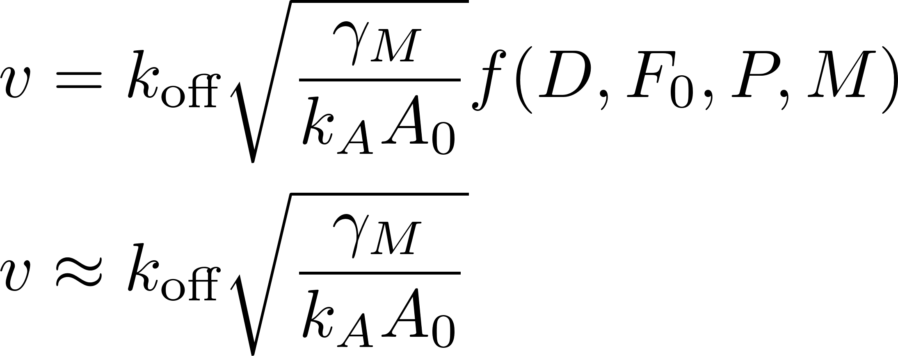
Bleb velocity depends on membrane tension but not pressure or actin turnover
Lim and Mahadevan 2012 Euro Phys Lett

Slide 17
Analysis of traveling waves in a non-local model of cell surface mechanics.
Kathryn Manakova, Yoichiro Mori, Jun Allard

Slide 18
What determines whether bleb travels or heals in place?

Slide 19
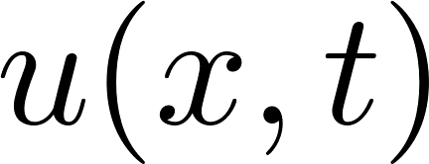




Travelling waves solutions
Travelling wave is a wave which travels without a change of shape
If represents a travelling wave, the shape of the solution will be the same for all time and the speed of propagation of this shape is constant
If we denote this constant speed by , then
By using this new “wave variable”, , partial differential equations in and become ordinary differential equations in

Slide 20
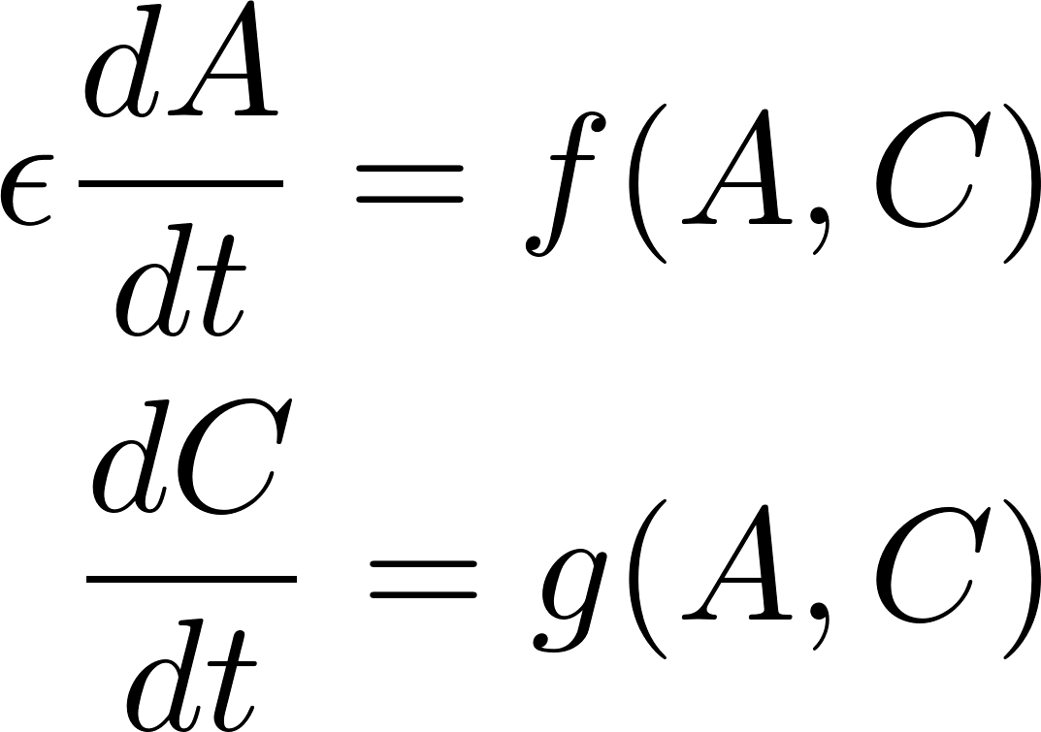
ODE system and excitability
A general two-component ODE system with a separation of timescales can exhibit excitability

Slide 21
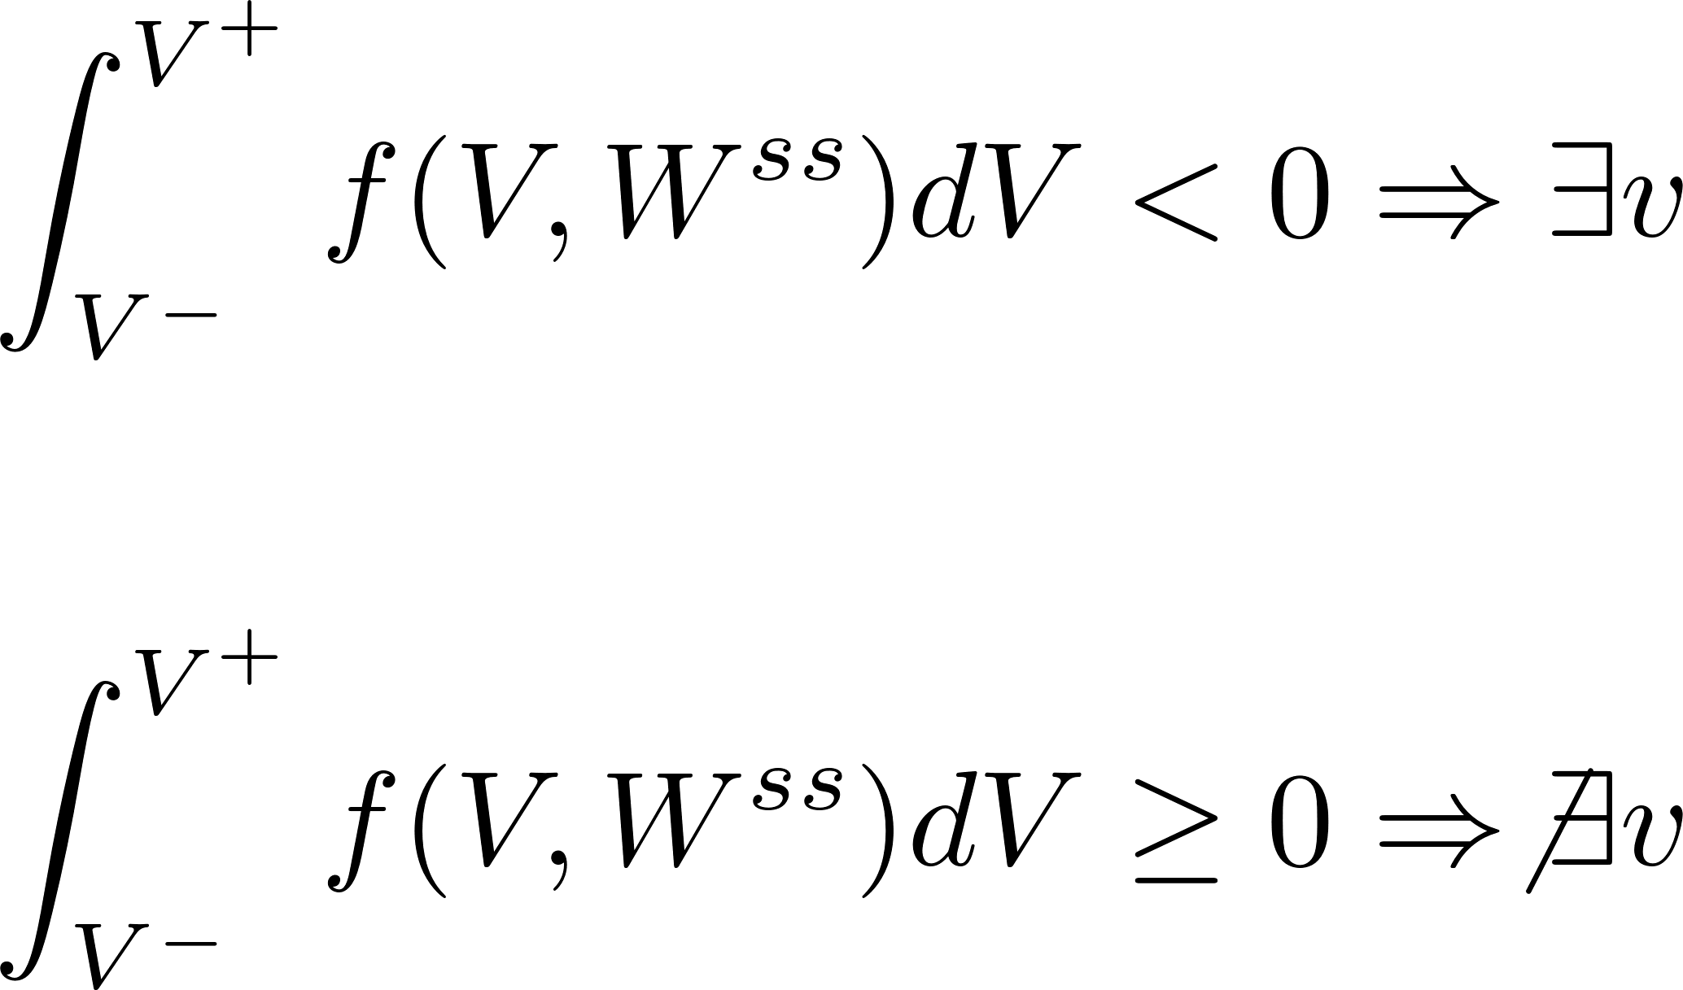
Maxwell Condition
Travelling wave
Maxwell Condition
Stationary excitation

Slide 22
Bleb model ODE
Blebs will form when the system is in the excitable regime

Slide 23
Bleb model ODE excitable regime
Note: log scale
This system never satisfies Maxwell condition yet still generates travelling waves
Is there an analogue of the Maxwell condition for the bleb model?
A⁻
A⁺

Slide 26
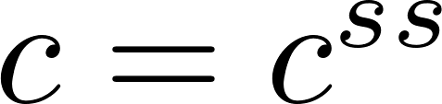

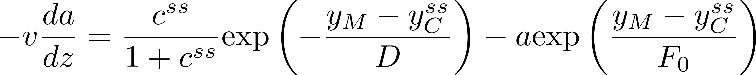
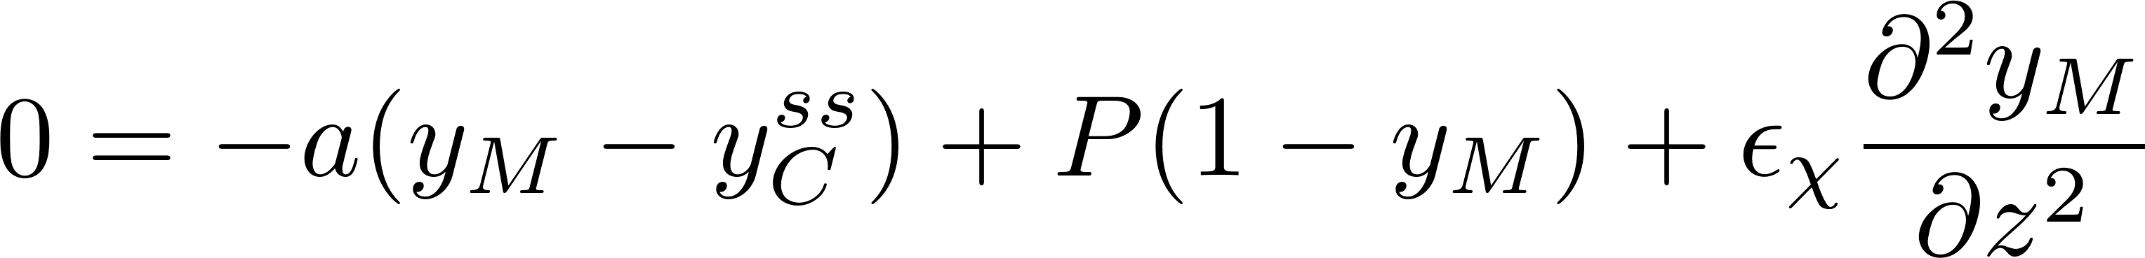
Bleb wave analysis
In the fast timescale, we have
We will also make the assumption that that cortex does not move during excitation
Transform to wave coordinate z:

Slide 27
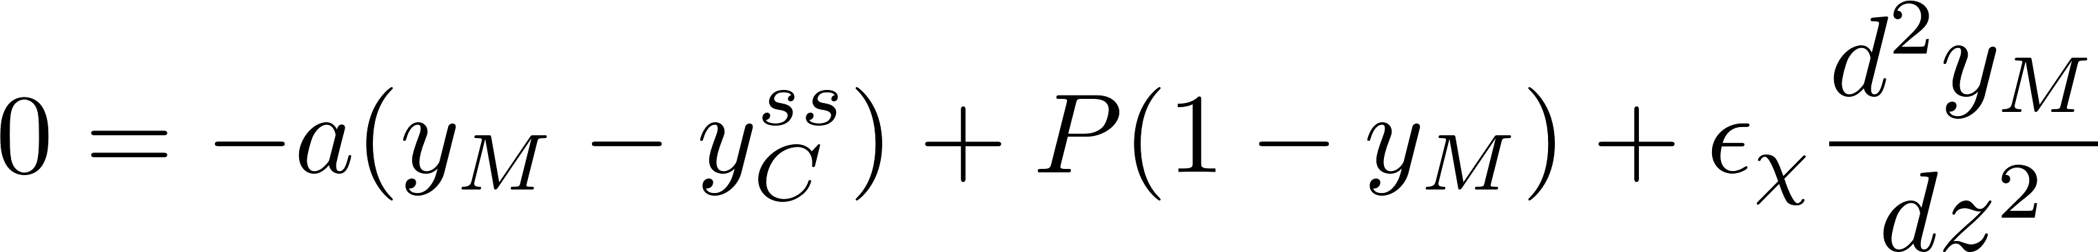
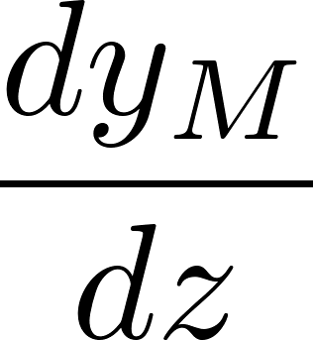
Bleb wave analysis
Multiply first equation by

Slide 28

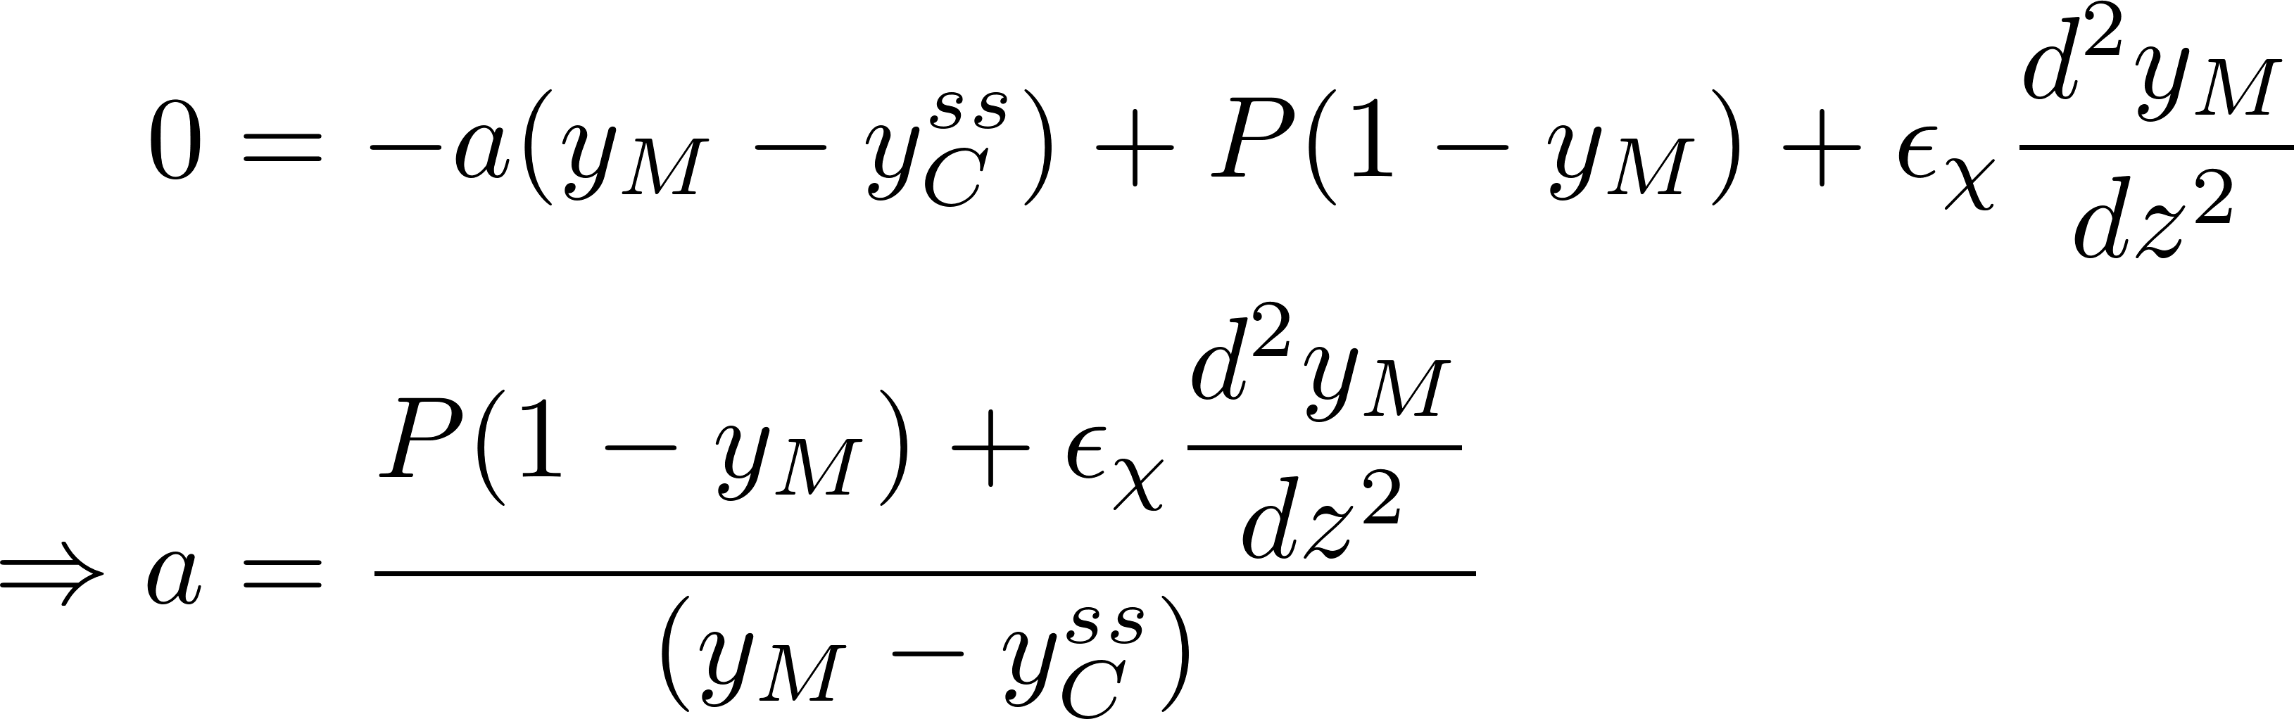
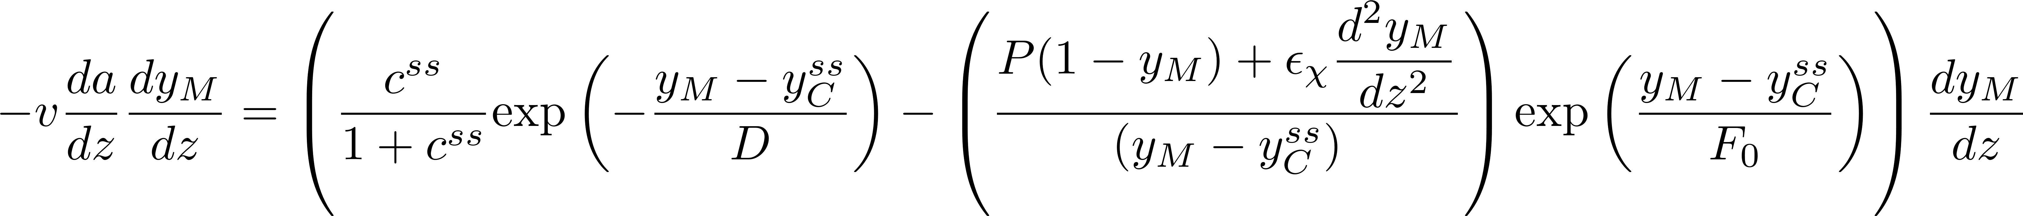
Bleb wave analysis
Use force balance equation to eliminate

Slide 29
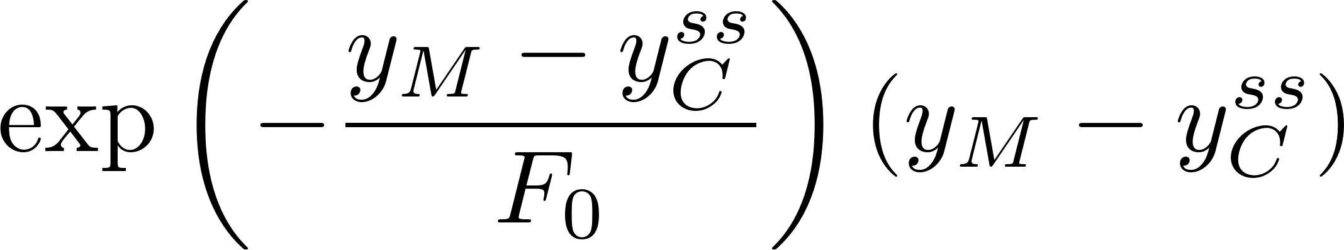
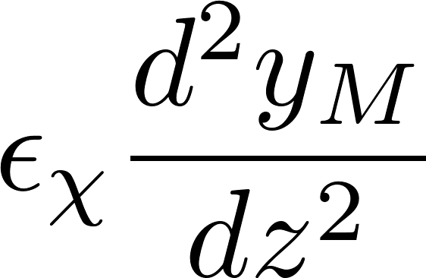
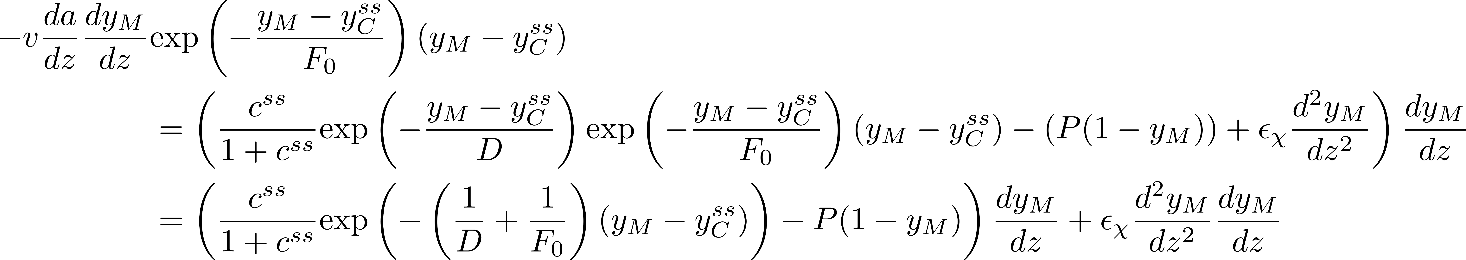
Bleb wave analysis
Multiply by
to isolate

Slide 30
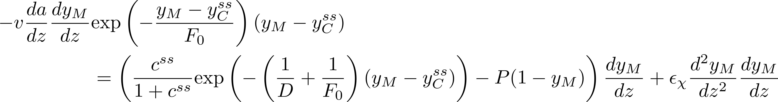
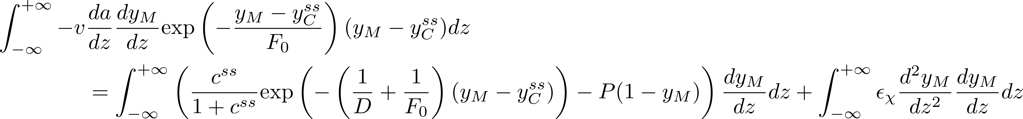
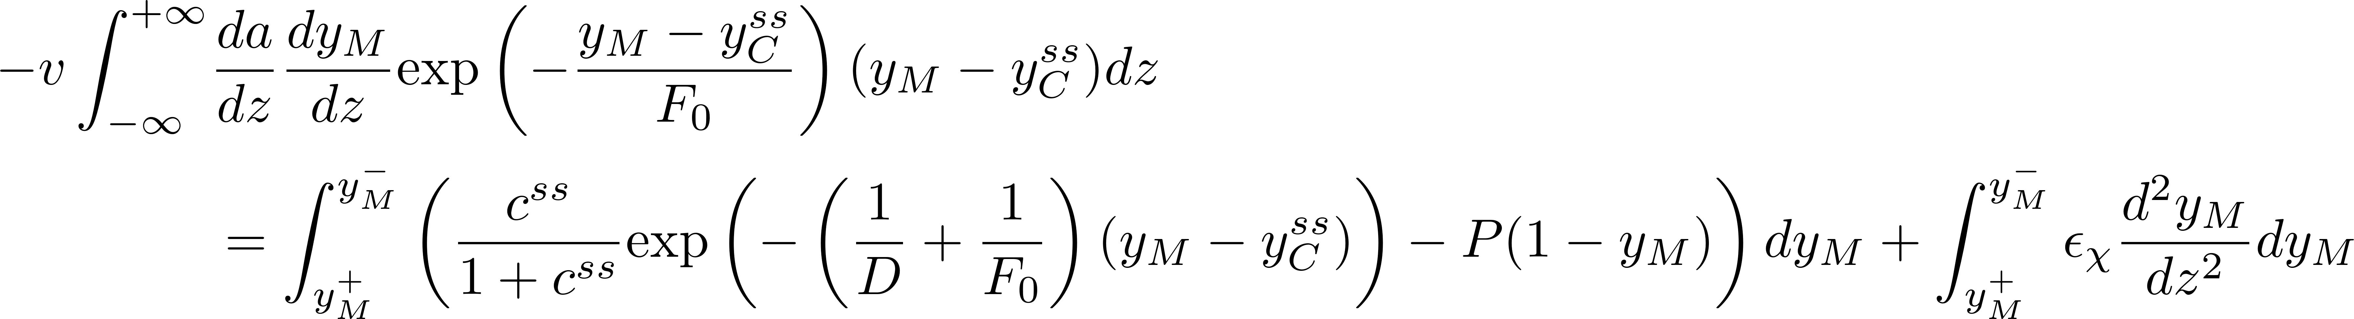
Bleb wave analysis
Integrate in z

Slide 31
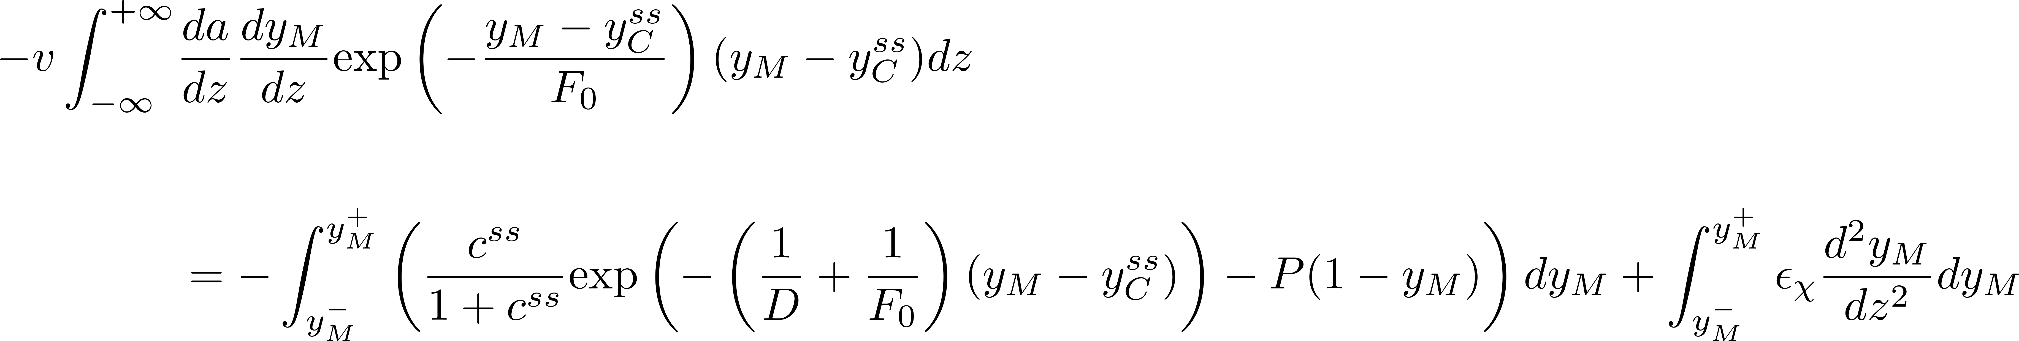
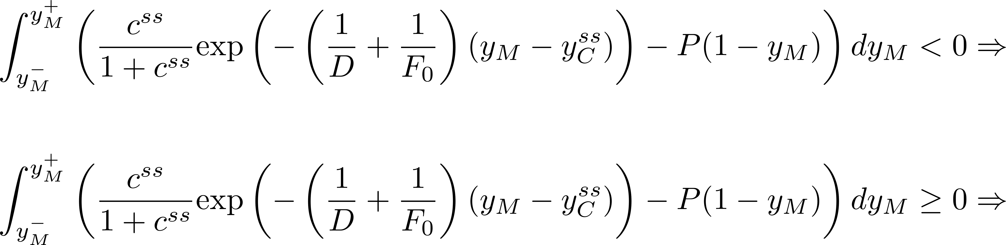
“Non-local Maxwell Condition”
Of determined sign (-)
0
Non-local Maxwell Condition
Travelling wave
Stationary excitation

Slide 32
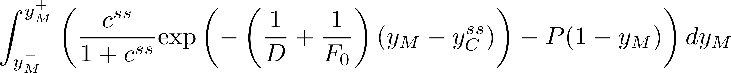
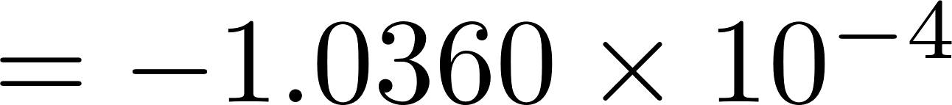
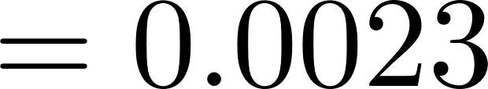
Numerical Results

Slide 33
Modeling the Mechanism of Nuclear blebbing and lamin-mediated defects in cardiomyopathies
Kathryn Manakova, Mehrsa Mehrabi, Anna Grosberg, Michael Zaragoza, Jun Allard

Slide 34
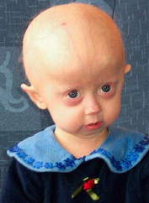

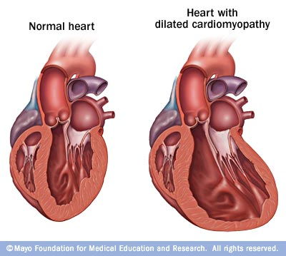
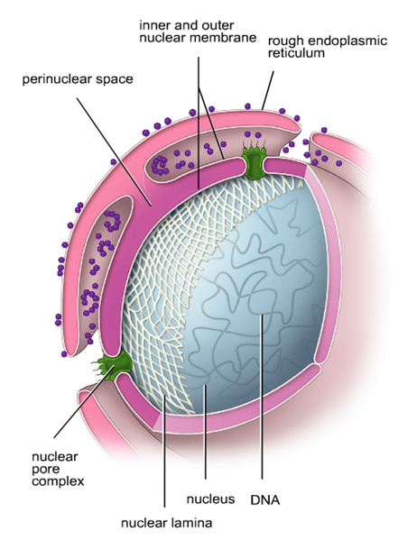
Gene mutation and Heart Disease
Gene mutations can lead to heart diseases
Dilated Cardiomyopathy (DCM)
Valve disease
Arrhythmia
Lamin A/C (LMNA)
Progeria (HGPS)
Skeletal muscle disease
Heart diseases
https://en.wikipedia.org/wiki/Progeria https://uk.pinterest.com/explore/sam-berns/
Lamin
Mammalian Lamin consists of A, C and B(B1, B2)
Forming the inner layer of the nuclear
which stabilizes envelope structure of the nucleus
Mutation can effect the other protein structures out and inside of the nucleus
http://www.design4evolution.net/7-evolution-of-cells
Notes:
Gene mutations can lead to different diseases
Sick sinus syndrome (SSS), also called sinus dysfunction, or sinoatrial node disease ("SND"), is a group of abnormal heart rhythms (arrhythmias) presumably caused by a malfunction of the sinus node, the heart's primary pacemaker.
Dilated cardiomyopathy (DCM) is a condition in which the heart's ability to pump blood is decreased because the heart's main pumping chamber, the left ventricle, is enlarged and weakened. In some cases, it prevents the heart from relaxing and filling with blood as it should.
Atrial fibrillation (AF or A-fib) is an abnormal heart rhythm characterized by rapid and irregular beating

Slide 35
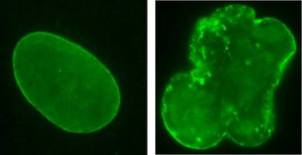
Lamin A/C and Nuclear Shape
Variations in the lamin can result in nuclei structural defect
Nuclei shape changes are reflected in the blebbing of the nuclear membrane
Not only is Lamin A/C suspected in regulating gene expression by interacting with chromatin, but the shape of the nuclei is suspected to affect gene expression
Normal nuclei
Defective nuclei
Progeria
nucleus
What is the correlation between cell structure and gene profile?
http://www.imetum.tum.de/en/research-groups/epigenetics/epigenetics/

Slide 36
Patient Specific Fibroblasts
Patients and their siblings volunteered for a skin punch procedure
Our collaborator cultured fibroblasts from those skin samples
There are over 25 cell lines in this project
Evaluate the mutations affect on:
Nuclear shape
Nuclear defectiveness
Cell`s ability to organize in response to ECM cues
How do we explore structural and functional differences among these cell lines in vitro?
Notes:
Structural evaluation

Slide 37
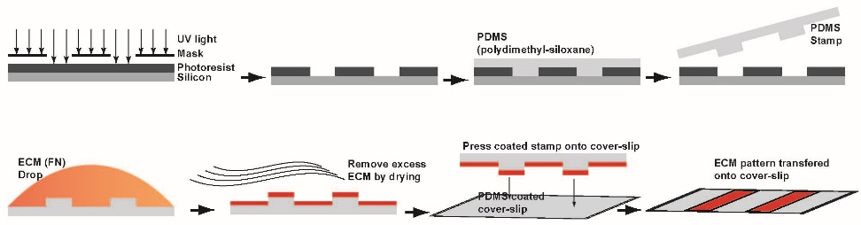
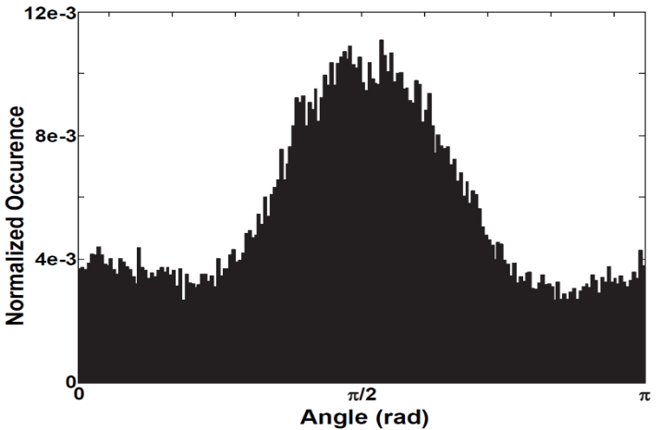
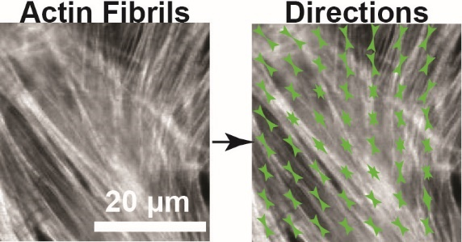
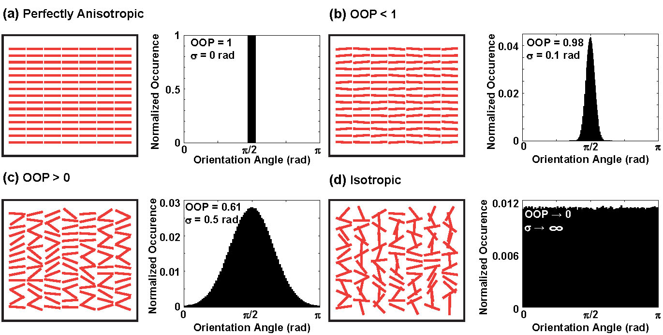
Quantifying Orientational Order Parameter (OOP)
Isotropic
Anisotropic
Microcontact printing allows us to create a custom pattern of ECM instead of an isotropic one
Histogram of
Orientation Angles
OOP=0
OOP=1
Notes:
Organization of constructs in a tissue can be characterized with an orientational order parameter (OOP)

Slide 38
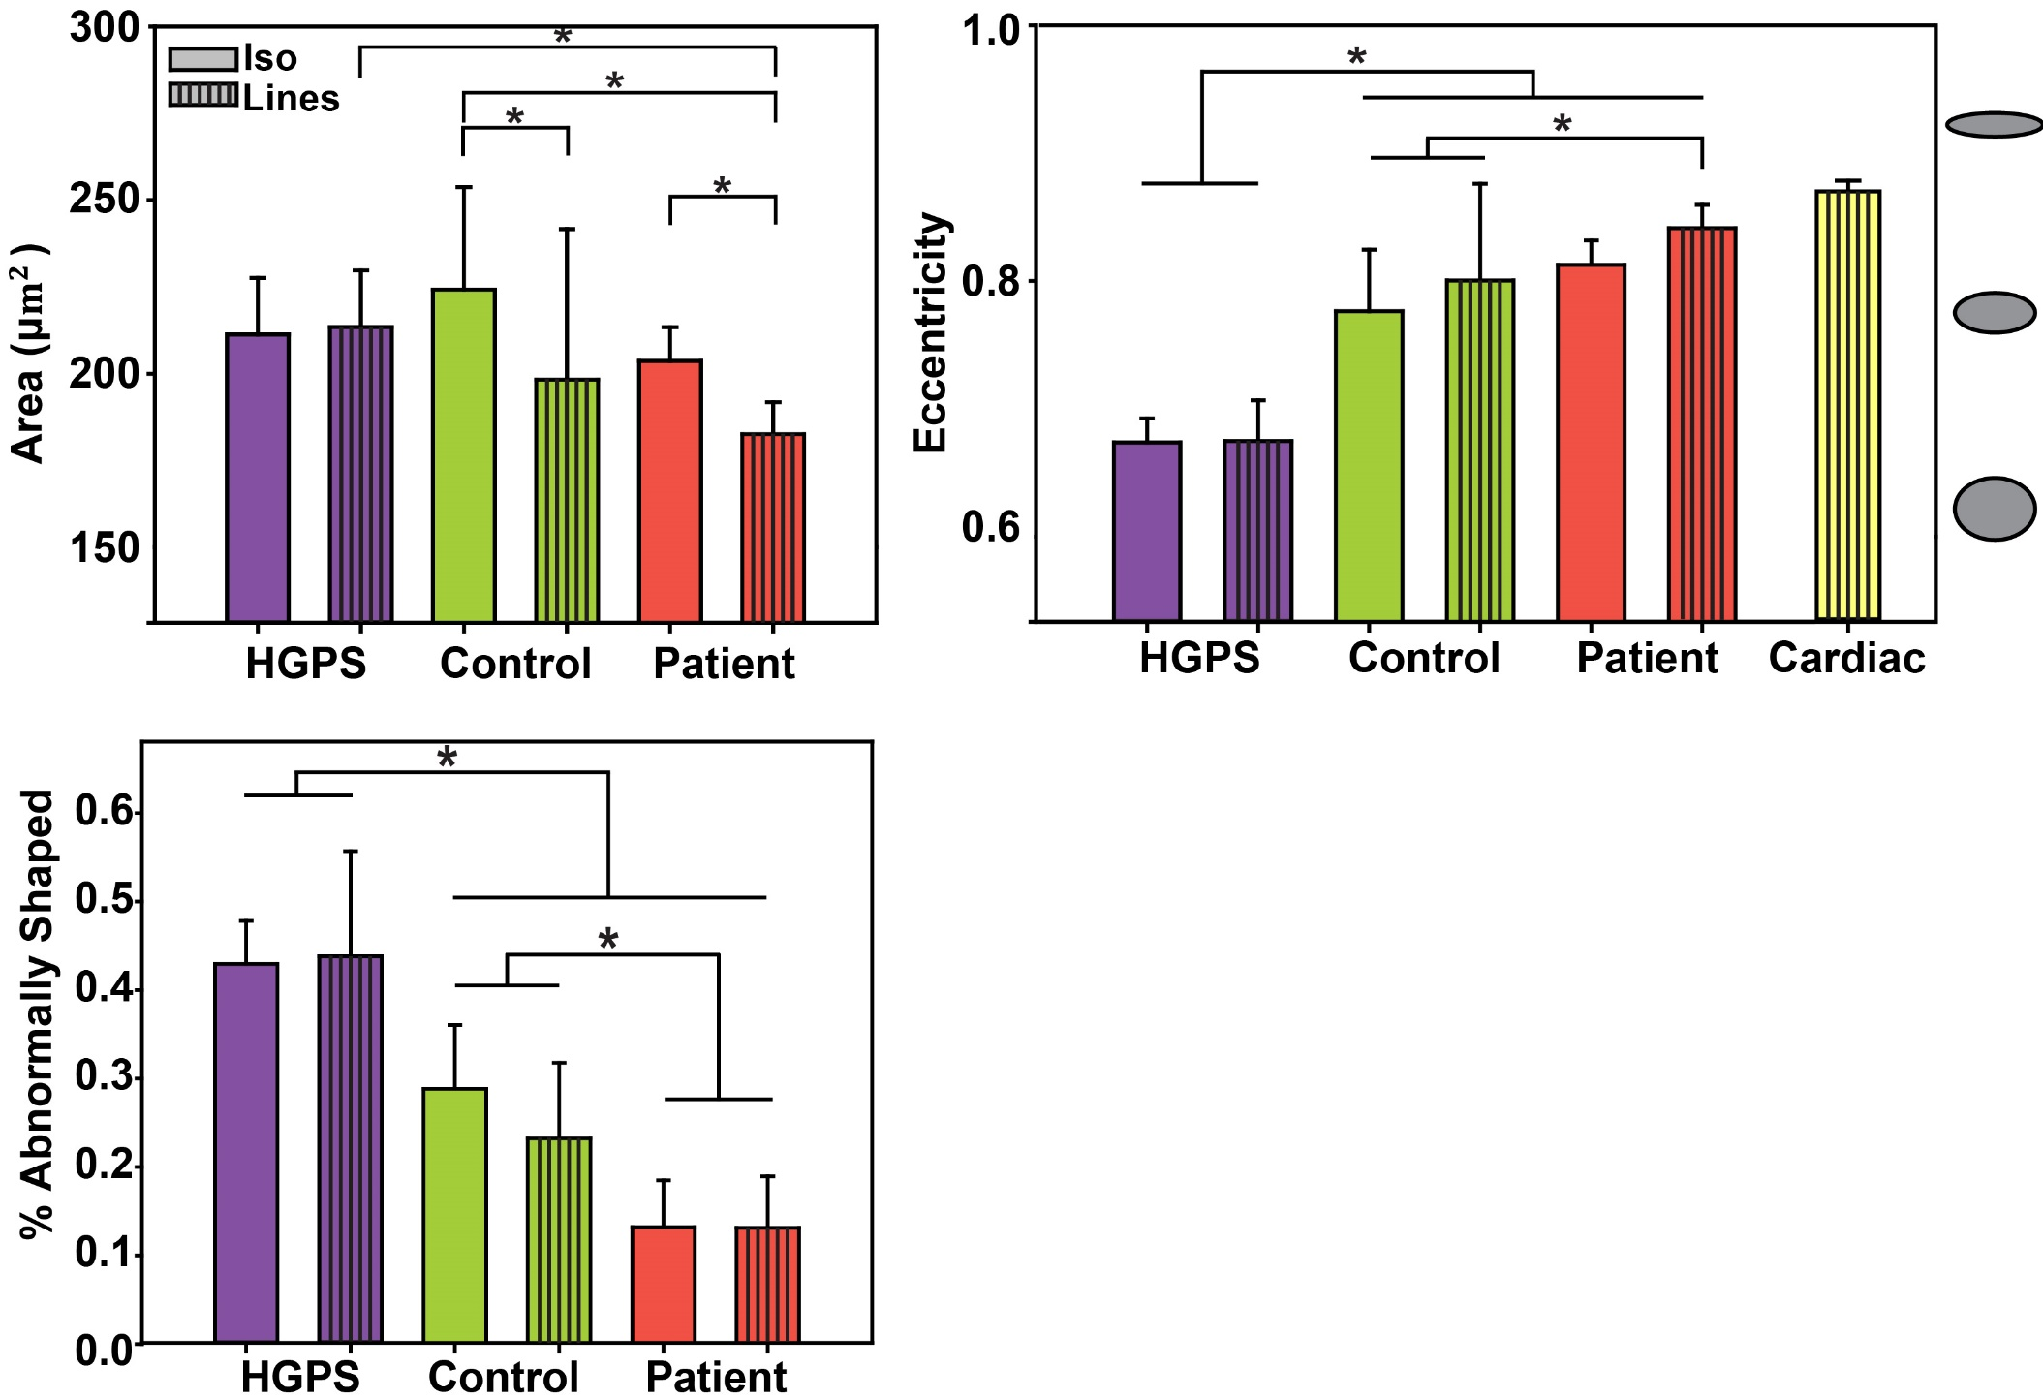
Quantitative Comparison
Intuitive metrics allow us to notice curious differences between the cell-lines, and to pose new hypothesis
This data is consistent with the patients exhibiting only heart disease symptoms, but raises interesting questions about implications
Core et al, ( in preparation)
Notes:
zDoes the lamin mutation change the mechanical properties of nuclear lamina?
How does lamin mutation can change cell cytoskeletal properties?
Why these particular lamin A/C mutations are heart specific symptoms?

Slide 39
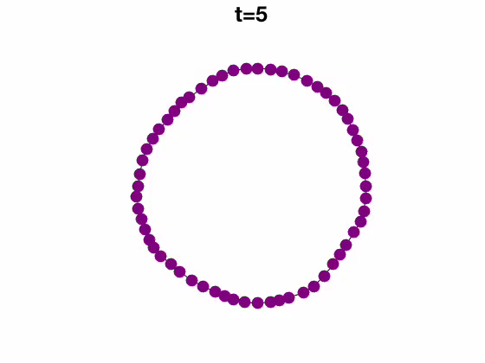
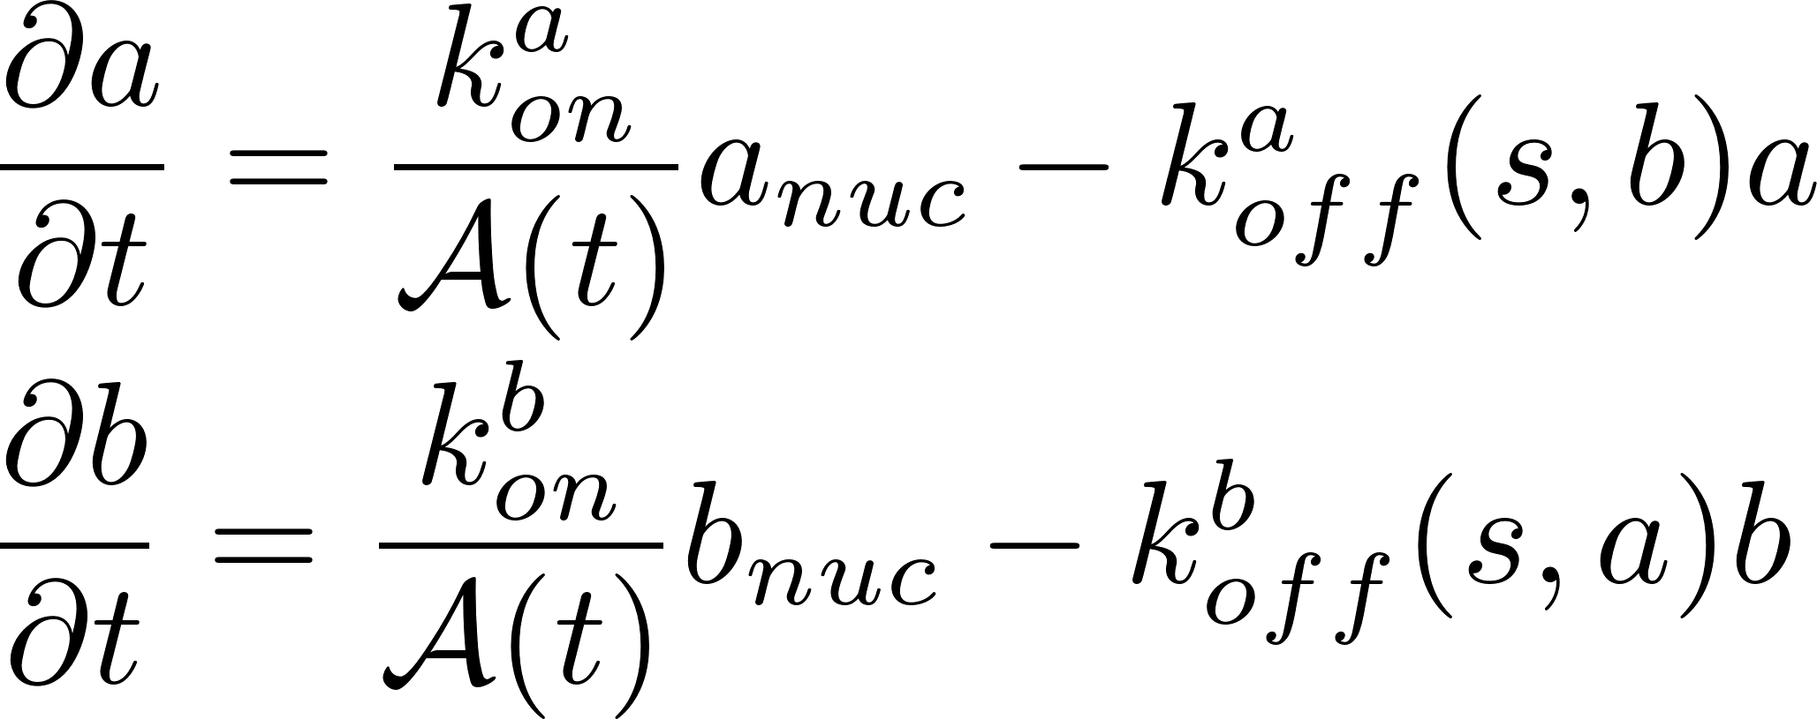
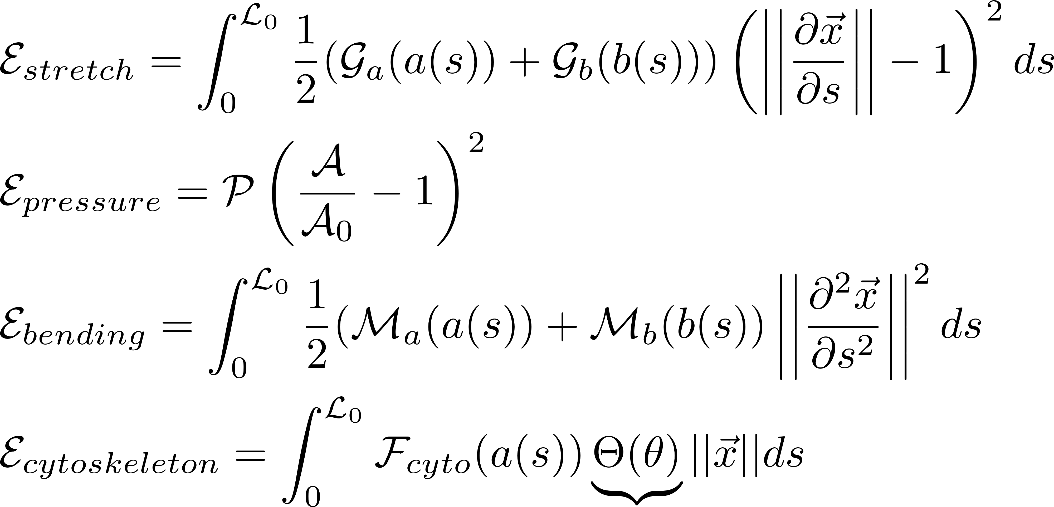
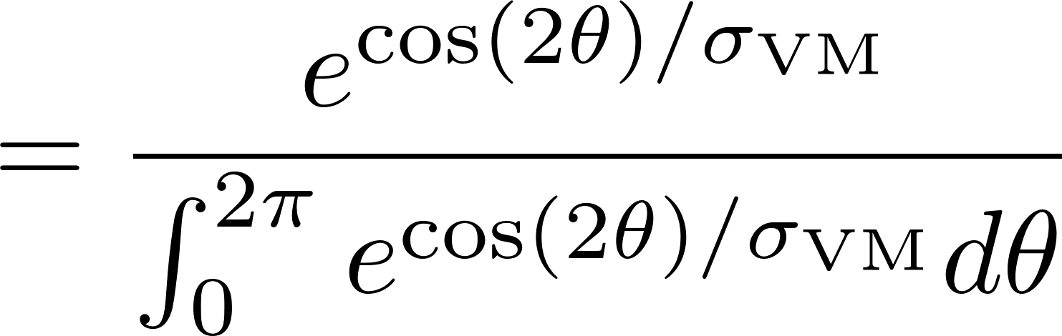
Mechanical Model of nuclear lamina
Assembly kinetics
Lamin A/C
Lamin B
Mechanics
→ Surface tension of lamina
→ Hydrostatic pressure of nucleus
→ Bending resistance due to
lamin-lamin crosslinks
→ Cytoskeletal force
These parameters are unknown

Slide 40
Model can be tuned using experimental data
Cellular Aspect Ratio
F-actin OOP
Nuclear Eccentricity
Nuclear Area
Nuclear Perimeter
20µm
Drew et al. (2016) Multiscale Characterization of Engineered Cardiac Tissue Architecture. J Biomed Eng.

Slide 41
Features in the data we can try to match
Diagonal: Distributions of variables
Off diagonal: Correlations between variables

Slide 42


Matching area and perimeter histograms
Ratio of surface tension to hydrostatic nuclear pressure
Rest (unstressed) nuclear perimeter
Experimental data for cells with Aspect Ratio =1
Simulated data

Slide 43





Matching OOP-eccentricity plot
Experimental data
Simulation
Best fit

Slide 44




Mechanical Model of nuclear lamina
Assembly kinetics
Lamin A/C
Force line density of the cytoskeleton
Lamin B
*
Mechanics
Stretch modulus associated with lamin B
Bulk modulus
Bending modulus associated with lamin A/C, B
*Kuo et al. (2012) Myocyte Shape Regulates Lateral Registry of Sarcomeres and Contractility. Am J Pathol.

Slide 45



Future work: What is the nature of nuclear “defects”?
Soft nuclei
Feedback
Decreasing bending modulus
?

Slide 46
Supplementary notes on Maxwell Condition

Slide 47

Travelling wave solutions and reaction diffusion equation
A general two-component ODE system with a separation of timescales with a diffusion operator in the fast variable can exhibit travelling waves

Slide 48

Fitzhugh-Nagumo as case example
Describes a prototype of an excitable system (e.g. a neuron)

Slide 49


Travelling wave solutions to Fitzhugh- Nagumo
I = 0.5, a = 0.01, b = 0.1, c = -1.5

Slide 50


FitzHugh-Nagumo wave analysis
In the fast timescale:
Let

Slide 51

FitzHugh-Nagumo wave analysis
In the fast timescale:
W^{ss}
Since this wave front will dominate all the dynamics of the wave, this is where the analysis takes place
The wave can only travel from V⁺ to V⁻ in this context (velocity is always positive)
V⁻
V⁺

Slide 52



FitzHugh-Nagumo wave analysis
Multiply by
Integrate over

Slide 53


FitzHugh-Nagumo wave analysis
0

Slide 54
Maxwell Condition
W^{ss}
V⁻
V⁺

Slide 55


Numerical results Fitzhugh-Nagumo
Travelling wave
Stationary excitation

